Slide 1
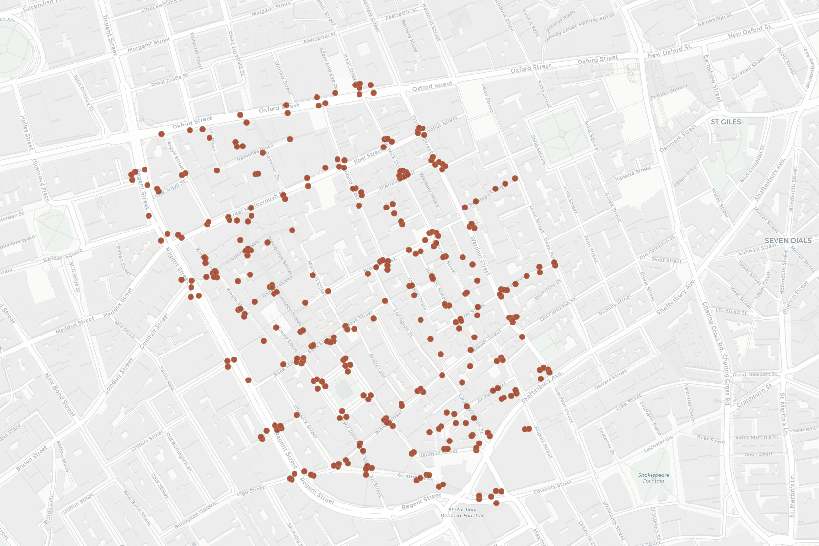
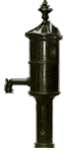
SEWER GRATES IN LONDON’S SOHO NEIGHBORHOOD (1855)
Broad St Pump

